Slide 1
The setup() method is used to initialise variables, set baud rate and create the Scale objects used for measuring.
If the system has power, the Boolean variable tareFlag is checked to see if the TareSet interrupt has been called. If so, tareFlag = True and tareFunc() is called.
Main
setup()
Does system have power?
3) If false, the battery level is checked.
4) Then, totalWeight is calculated from both Scales and both Channels.
5) totalWeight is then checked to see if the weight exceeds 190lbs (the maximum for the load cells). If true, overload_warning() is called.
6) Otherwise, the totalWeight is displayed on the LCD.
End
No
Yes
Is tareFlag = True?
tareFunc()
Yes
checkBattery()
Calculate totalWeight from all four Load Cells
Is totalWeight > 190kg?
Yes
overload_warning()
No
Display totalWeight on LCD

Slide 2
setup()
LCD screen and baud rate for serial communication are initialised.
Button connections are set, and relevant interrupts are attached to each (ISR_TareSet to Tare Button, ISR_Unit to Unit Button). Pullup resistors are enabled to ensure the buttons either give a 0 or a 1.
Two methods, start_screen() and initialise_HX711_modules() are called.
Both scales on both channels are calibrated.
The main loop() is then reached.
Initialise LCD screen
Initialise buttons and attach interrupts.
start_screen()
Initialise_HX711_modules()
Calibrate both scales in both channels
loop()

Slide 3
start_screen()
Once called, introductory message shown to the user – letting them know that the scale is on.
1.5 second delay to leave the message on the screen.
Returns to setup() method.
Display introductory message
1500ms delay
Return

Slide 4
initialize_HX711_modules()
Once called, connections are initialised for each HX711.
A while loop is used to check if both HX711 modules are ready. This is done by using the “is_ready()” method that is built into the HX711 library. It returns a Boolean value (True/False) that is used to control the iteration.
If either of the modules are not ready, a suitable message such as “Please connect HX711” will be displayed on the LCD screen.
Otherwise, the user is notified that the HX711 modules are connected via a suitable message on the LCD screen – “HX711 ready!”
Returns to the setup() method.
Initialise HX711 connections
Are both modules ready?
Display suitable message
No
Yes
Display suitable message
Return

Slide 5
channel_change(int gain)
One integer argument is expected by the method (gain).
Gain is set for the HX711 modules using the “set_gain” method which is built into the HX711 library.
The gain relates to which channel is being read from. A gain of 64 is Channel A, a gain of 32 is Channel B. These must be switched between to read from both load cells attached to a module – hence why this method is mandatory.
Returns to main code.
Set gain for Scale 1
Set gain for Scale 2
Return

Slide 6
measure_scaleX()
*X = 1, 2
There are two versions of the function – one for each of the two HX711 modules.
The loadcell is measured, and the result is stored in a floating-point variable.
If the variable is less than 0, it is simply set to 0 to prevent false readings.
If the variable is greater than 0, the variable is returned to the program for more calculations.
Get measurement from scale X and store it in a float variable
Is variable > 0?
No
Variable = 0
Yes
Return variable

Slide 7
overload_warning()
Display warning message
This method is called if the total reading from both loadcells in both channels (in pounds) exceeds 190lbs.
A warning message is then displayed until the load on the scale drops below 190lbs.
1000ms delay
Return

Slide 8
tareFunc()
HX711 modules are tarred on both channels.
initialWeight is reset.
A suitable message is outputted to the user.
Returns to the main program.
Tare both HX711
Set initialWeight to 0
Display suitable message
Return

Slide 9
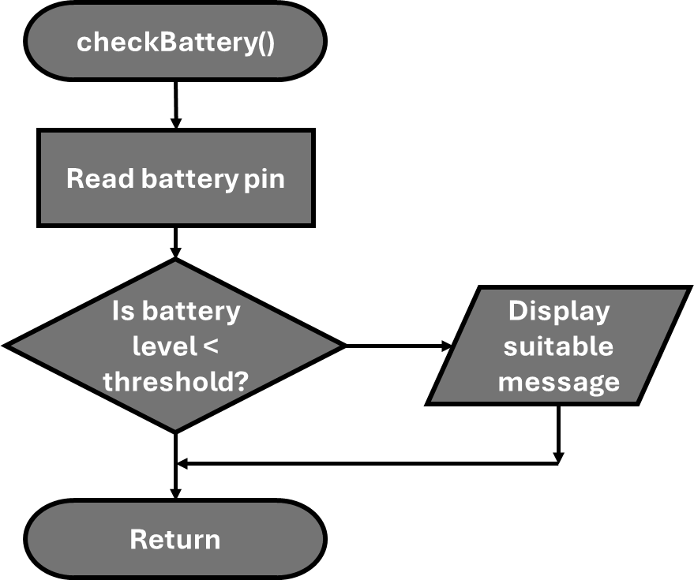
When called, this method reads the voltage on one of the analog pins – scaled down with a voltage divider.
If the level is lower than the threshold, a suitable message is displayed.
Otherwise, return to main program.
Yes
No

Slide 10
ISR_TareSet()
The interrupt turns the volatile Boolean variable tareFlag to true.
This value is returned to the main program, where a selection statement is used to trigger TareFunc(). tareFlag resets to false in the selection statement to prevent it triggering again.
The code stored in TareFunc() could be stored in this ISR, however ISRs should be kept short. This is because interrupts can block other interrupts – meaning other button presses could be missed.
tareFlag = True
Return

Slide 11
ISR_Unit()
When called, unitMode is incremented. unitMode is declared volatile so its value is always checked as its value can change at any time.
The variable counts from 0-3 (inclusive) and each value relates to a measurement (0 = kg, 1 = g, 2 = lbs, 3 = st).
The selection statement used in main converts the integer into a comprehensible string.
Increment unitMode
Return

